Slide 1
Configuring Traffic Manager, App Gateway & App Services with Terraform
Stephen Weinrich
16th August 2018

Slide 2
Agenda
Desired State Architecture
Terraform
App Services
Application Gateway
Traffic Manager
Limitations
Client Example
Q & A

Slide 3
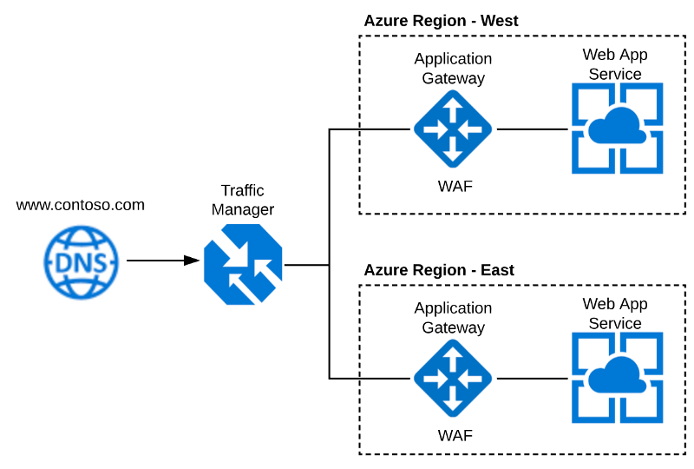
Desired State Architecture

Slide 4


Terraform
Microsoft Azure | Cortana Analytics | Cloud data architecture
What
Major Cloud Providers
Alternatives
Terraform is a tool for building, changing, and versioning infrastructure safely and efficiently.
Azure
Azure Stack
AWS
Google Cloud
AliCloud
ARM Templates
Azure CLI
PowerShell
Cloud Formation Templates
Ansible
Chef, Puppet
https://www.youtube.com/watch?v=wgzgVm7Sqlk

Slide 5
Terraform Demo
Terraform [ter-uh-fawrm] - to alter the environment in order to make capable of supporting terrestrial life….in the cloud.
Notes:
mkdir /c/code/contoso.com
mkdir /c/code/contoso.com/infrastructure
cd /c/code/contoso.com/infrastructure
copy environment.tf and config.dev01.tfvars file into folder
open in vscode
look at and explain 2 files
create azure principal account
give it access to subscription
copy paste azure required values
terraform init
terraform workspace new dev01
terraform plan -var-file=config.dev01.tfvars
terraform apply -var-file=config.dev01.tfvars
look at state file, talk about a central state file
review resource groups created in azure portal
terraform destroy -var-file=config.dev01.tfvars
terraform apply -var-file=config.dev01.tfvars -auto-approve
talk about vsts build/release pipelines

Slide 6
Desired State Architecture

Slide 7
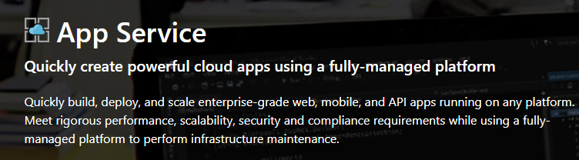
Terraform
Microsoft Azure | Cortana Analytics | Cloud data architecture
App Service Plans
Supports
Features
Dev / Test
F1, D2, B1-3
Production
S1-3, P1-3,P1-3(V2)
Isolated
App Service Environment
.NET
Node.js
PHP
Java
Python (on Linux)
HTML
Fully-managed platform
AAD Authentication
Custom Domains + SSL
Networking
Scaling Up and Out
Continuous Deployment
Many more….

Slide 8
App Service Demo
The original project for what ultimately became Microsoft Azure was a project code-named “Project Red Dog”.
Notes:
copy sample code into environment.tf file in vs code
talk through it
terraform workspace select dev01
terraform plan -var-file=config.dev01.tfvars
terraform apply -var-file=config.dev01.tfvars -auto-approve
look at created resources in azure
browse to created app services
add deploy credentials
update both east and west with demo source code using filezilla
look at both websites to see the changes
talk about other deployment options, VSTS, CI + Pipelines

Slide 9
Desired State Architecture

Slide 10
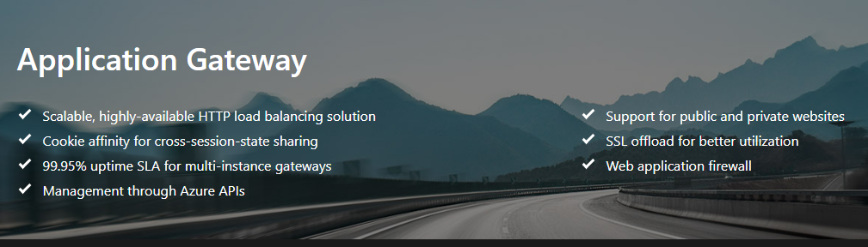
Terraform
Microsoft Azure | Cortana Analytics | Cloud data architecture
Why?
Concepts
Features
Protect web applications from attack
Host multiple applications behind one gateway
Restrict traffic to your web applications through the gateway
Enable SSL termination at the gateway level
Frontend Public IP Address
Port Listeners
Rules
Backend Pools
Probes
Web Application Firewall (WAF)
Protection from DDOS
Protection from XSS
Protection from SQL Injection
OWASP 2.0 or 3.0 Specification
Path Based Routing
SSL Termination
VNET Support

Slide 11
App Gateway Demo
OWASP - Open Web Application Security Project

Slide 12
Desired State Architecture

Slide 13
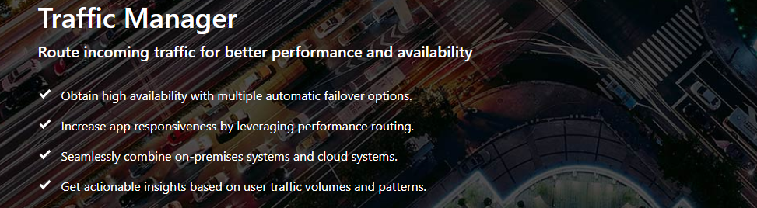
Terraform
Microsoft Azure | Cortana Analytics | Cloud data architecture
Why?
Limits
Features
Route traffic across Azure Regions
App Service Plan : S1 and above
DNS Based Load Balancing
Priority
Weighted
Performance
Geographic

Slide 14
Traffic Manager Demo
TRATHECK

Slide 15
Desired State Architecture

Slide 16
Limitations
HTTP2
IP Restrictions
Configuration not currently supported by Terraform
Post deployment PowerShell script
Will only work if using HTTPS
Configuration of IP Restrictions for App Services not currently supported by Terraform or PowerShell Cmdlets.
PowerShell hack can be used, Cmdlets coming “soon”
Only works with Standard and above App Service Plans
pickHostNameFromBackendAddress
Configuration not currently supported by Terraform
Post deployment PowerShell script or manually using Resource Manager
Ideally this could be part of an App Service selection instead of FQDN selection
WAF Detection vs Prevention
Strict OWASP rules prevent traffic flow
Use Log Analytics in Detection mode to understand rules better
HTTPS
Traffic Manager
Configuration of Redirection on a Rule is not currently supported by Terraform
PFX certificate is required for Terraform configuration
Only supports Standard App Service Plan and above (if bypassing gateway)
Clear cache and flush DNS for accurate testing
nslookup is your friend

Slide 17
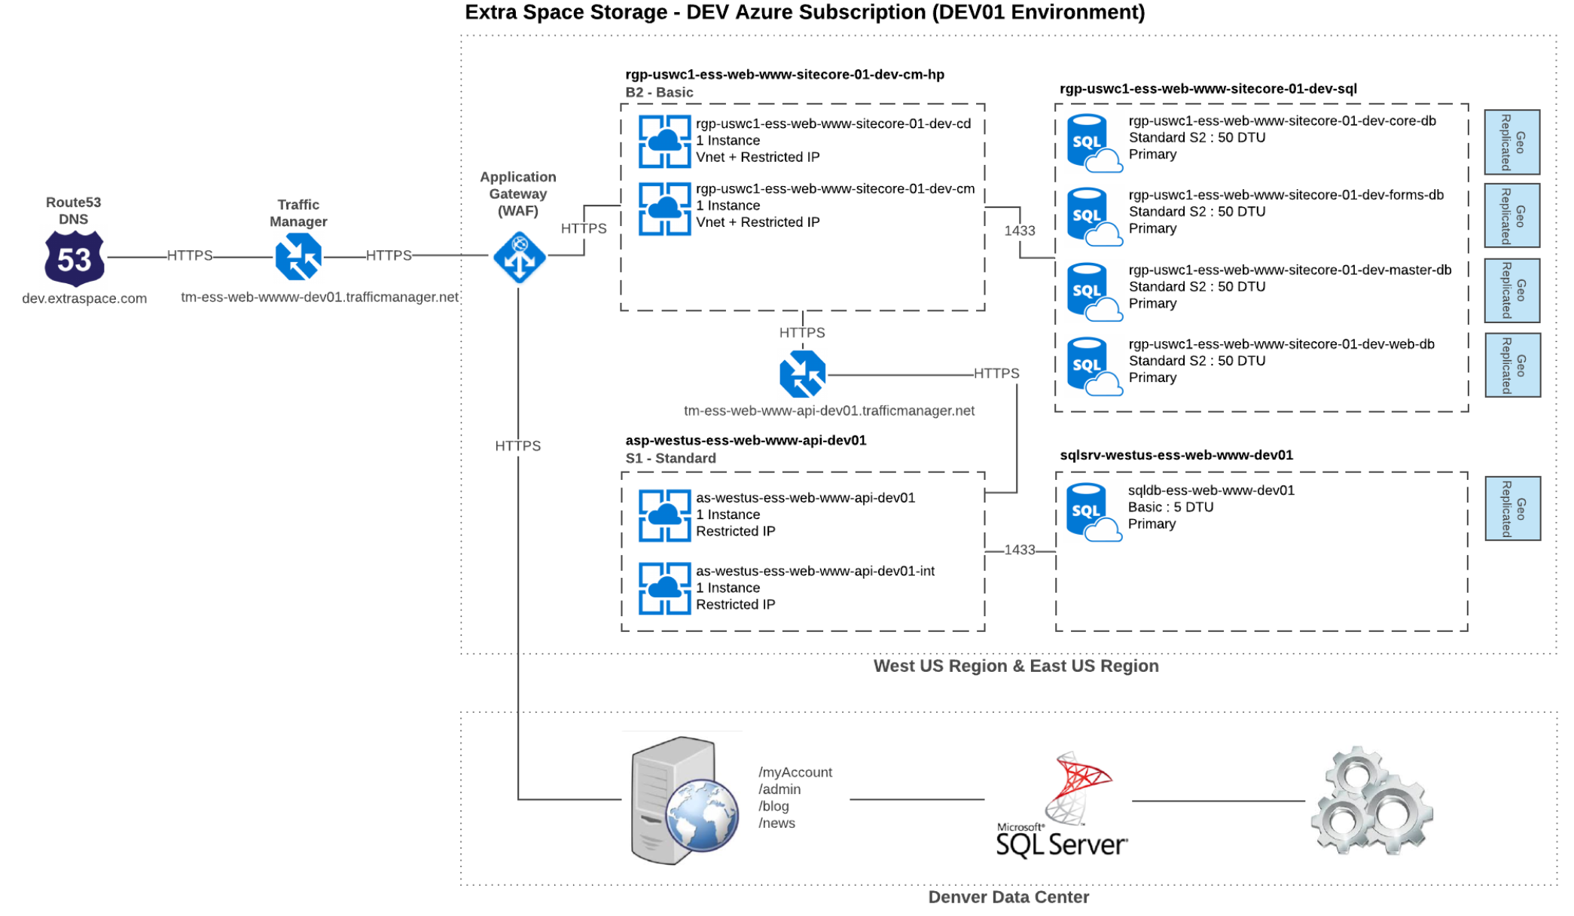
Client Example

Slide 18
Q&A

Slide 19
Resources
Medium Blog Post URL
Terraform Azure Provider
Azure Resource Explorer
Enable HTTP2 Script
pickHostNameFromBackendAddress Script
Add IP Restrictions Script
All Code + This Presentation

